Slide 1
RC & Ardupilot

Slide 2
ArduPilot Firmware
Firmware that runs on Flight Controller Hardware
Used for GPS-based autonomous (or semi-autonomous) flights
PX4 is an alternative but harder to use
Different versions: ArduPlane, ArduCopter, ArduRover, ArduSub, etc.

Slide 3
Flight Controller Hardware
Standard ‘PixHawk style’ has same connectors, so peripherals plug in easily
RadioLink PixHawk
Predessor was called APM
CubePilot Orange+ Cube
HolyBro
PixHawk 6X standard set $325
PixHawk 6C mini $
Matek Wing Boards
Omnibus
Linux-Based
3rd party hardware that does not look like the PixHawk-style

Slide 4
Pixhawk Flight Controller
This is a ‘style’ of controller with standard connectors
I have a PixHawk v2.4.8 but NOT a Cube
Stuff that needs to be plugged in:
Servos
Telemetry – get in-flight real-time data back to controller
GPS / GNSS (supports GPS, BDS, GLONASS, GALILEO, QZSS, IRNSS)
Battery voltage adapter to Pixhawk-friendly voltages
Receiver / Antenna
IMU (Inertial Measurement Units): accelerometers / gyroscopes / magnetometers
Altitude: Barometer
Air speed sensor
Camera
Lidar
Buzzer for feedback
Connect via microUSB cable and hit ‘Connect’ button from Mission Planner

Slide 5
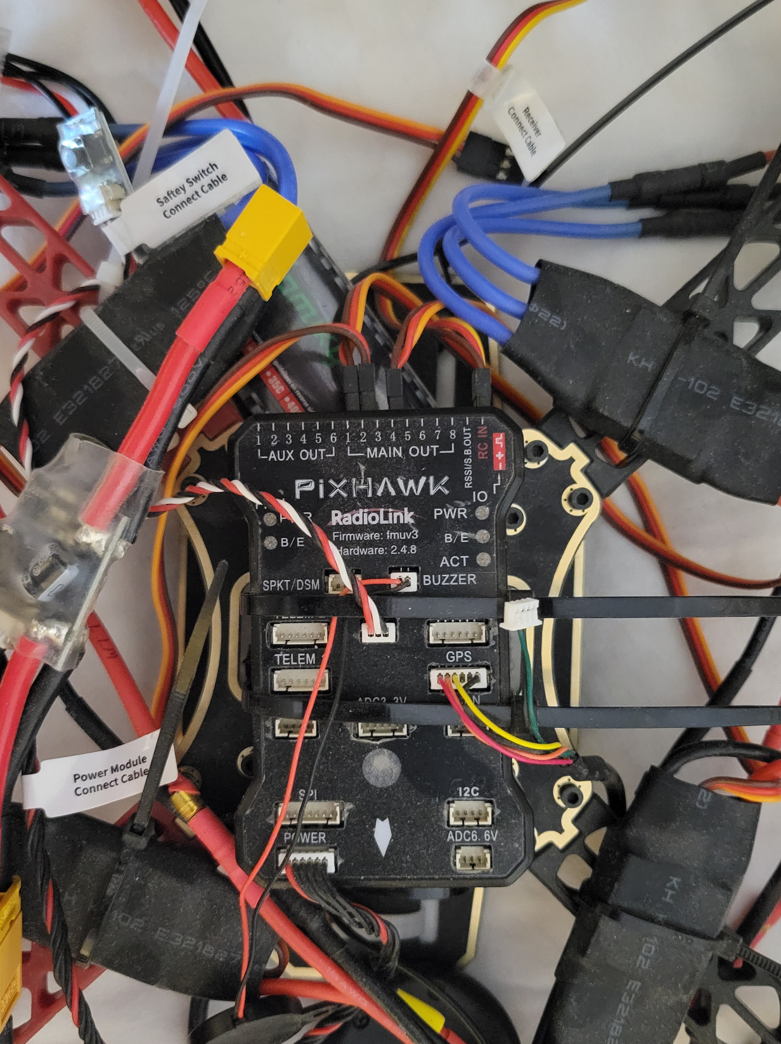
RadioLink PixHawk v2.4.8
Firmware FMUv3
Connect to a receiver to also
control via joystick controller
To motor ESCs / servos
Power regulator
to give PixHawk-friendly
voltage
To GPS / GNSS ‘dome’
Buzzer for feedback

Slide 6
CubePilot Cube
Cube plugs into something that looks like PixHawk but actually says CubePilot on it as well
Orange+ is latest & greatest $350
Cheaper mini purple version for ground vehicles
Original version of Cube was black and called a ‘PixHawk 2.1’ but the named changed to just ‘Cube’

Slide 7
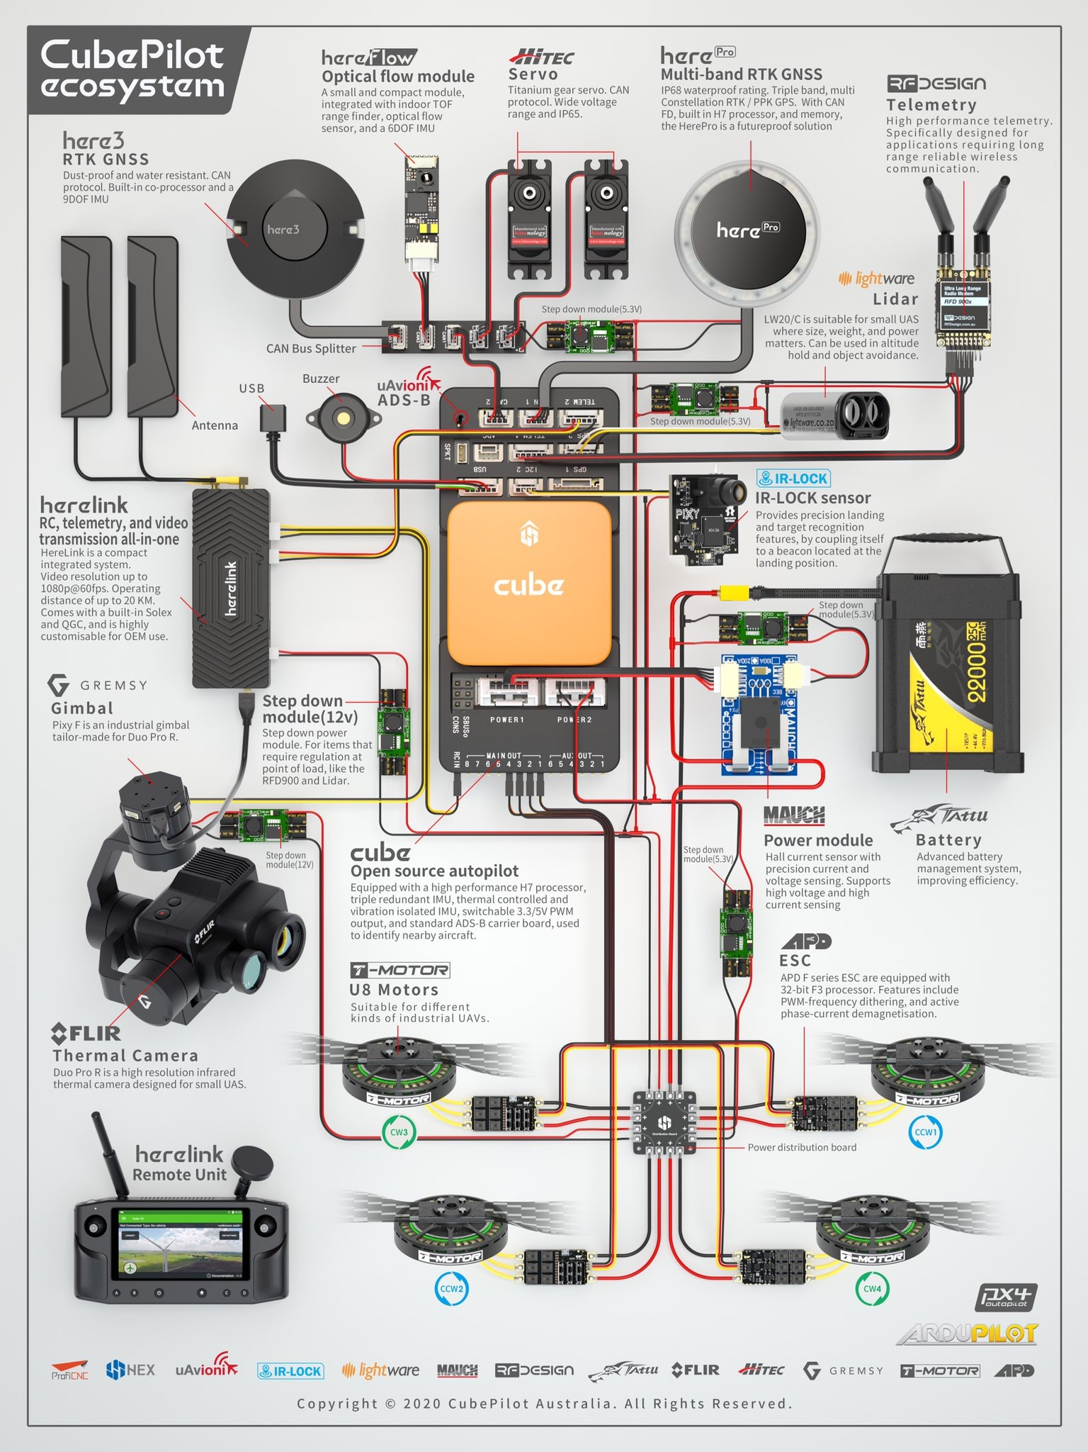
CubePilot Cube Orange+

Slide 8
Ground Control Software
Mission Planner is most popular and easiest, but also:
QGroundControl
APM Planner 2
could also run app from phone or tablet
Used to flash firmware onto the flight controller hardware
Used to monitor flight and control vehicle remotely
Can use in combination with a joystick-type controller, but it’s possible to have no controller at all. The point is an autonomous flight plan, anyways.
Can stop the flight and call back to home, etc.

